Slide 1
111 - Myth Busting

Slide 2
111 Myth Busting – Overview
It is commonly thought, throughout the Ambulance Service, that relations with 111 are not always positive, so behind the scenes a small team from EEAST is trying to change this.
The aim is to create a positive, learning culture and better understanding between the 111 Providers and EEAST.
Members of operational staff, clinical team and ECAT started undertaking 111 reviews a few years ago and now have monthly review calls with all of the 111 providers within EEAST.
The meetings involve end to end reviews of individual calls and any learning identified is fed back between organisations and staff. LOM’s/HALO’s and frontline staff are now also invited to these meetings to gain a better understanding of how 111 & EEAST work together.

Slide 3
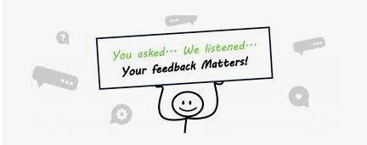
This engagement with 111 has already resulted in positive change.
We asked all 111 providers to ask patient/callers to wear a mask when crews arrive. 111 have now added this to their closing statement.
We asked crews ‘what information would you like to know about 111?’ The next few slides are your questions and the responses from 111.

Slide 4
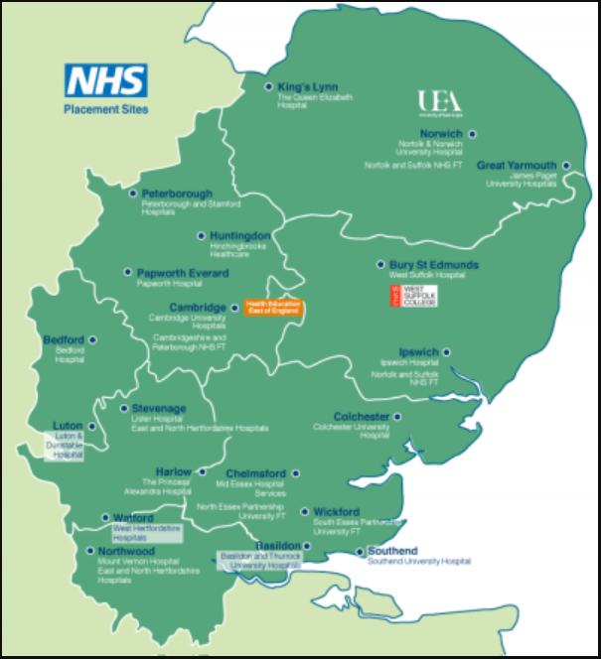
Map of 111 providers
IC24 Norfolk covers Great Yarmouth and Waveney
IC24 South Essex covers South East Essex and Mid Essex
HUC covers Hertfordshire, Cambridge, Peterborough Luton, Bedfordshire and West Essex
Practice Plus covers Suffolk and North Essex.

Slide 5
What Grade are 111 Clinicians?
Clinicians are equivalent to Band 6 on Agenda for Change. All clinicians must have had at least two years post qualification experience including recent acute or extensive primary care experience. IC24 have paediatric nurses who triage patients under 16yrs. They do not work 24hrs but work when we have the highest number of paediatric calls.
Does not use Agenda for Change. All clinicians are paramedics who have had recent front line experience or nurses who have ideally had A&E experience or extensive primary care knowledge.
They also have Dental Nurses, Mental Health Nurses, Pharmacists, ANPs and GPs.
Does not use Agenda for Change. All clinicians are nurses or paramedics who have recent front line experience.

Slide 6
Which Triage System Do 111 Use?
All 111 providers and some UK Ambulance Trusts use NHS Pathways which is a clinical algorithm tool, if appropriate it rules out immediately life threatening symptoms first. The system is not designed to diagnose but simply to rule out. It contains a large amount of care advice within the system.
Care advice is regularly reviewed and is based on the latest available evidence. NHS Pathways has support from the British Medical Association (BMA) and Royal Colleges involved in the delivery of urgent and emergency care.
NHS Pathways is under constant review and direction by the clinical community via the independent National Clinical Governance Group. This group oversees the clinical content and ensures that only the best evidence is applied to the care of patients who are assessed using NHS Pathways.

Slide 7
Are there “Red Flag” symptoms that generate an automatic response from 111 – Is there a clinician manual override like ECAT has?
There is no automatic response, however following an assessment if the disposition arrives at an ambulance response the ambulance is physically confirmed to dispatch. The 111 Health Advisors (HA’s) are non-clinical and use the NHS Pathways algorithms for the triage of the patient disposition. For C1 and C2 outcomes, HA’s are advised to follow the algorithm which incorporates red flag symptoms. All C3 dispositions are passed to clinicians for validation, if these calls are not actioned within one hour an ambulance will be automatically sent. Any ‘refused’ ambulance disposition are also reviewed by a clinician who can over-ride any disposition based on their history taking and using their clinical decision making. The system rules out any ABC red flags immediately, then pathway specific questions around the patients presenting complaint.

Slide 8
Is there any point in putting #111Review where do they go?
Yes, absolutely. If you feel there is a clinical reason for a case to be reviewed please carry on flagging these.
Please ensure that you explain why the review is required and use professional language
#111Review is a key word which enables us to run a report off. At the end of every month a spread sheet is compiled and split into the different 111 provider areas, this is then sent to the clinical lead. The clinical lead looks at every 111 review (approx. 300 calls) and decides which ones are clinically appropriate to send to the 111 provider to review the case.
111 audit every call we send them and assess the appropriateness of the call and, if necessary, feed back to their staff for learning. 111 sends back reviews to us and we feed back the findings to the crews/staff.

Slide 9
Does 111 have the ability to book ERS or Private Transport?
No, the NHS Pathways System is dependent on the DoS (Directory of Services) therefore can only refer or book into a service that presents on the DoS.
111 clinicians in Norfolk IC24 are able to refer to the Norfolk Swift Response Team for C4 responses where appropriate.
111 Clinicians for HUC can refer to the Joint Emergency Team (JET) for admission avoidance.

Slide 10
Why don’t 111 redirect patients to their own GP when they contact 111 “in hours”?
111 receives a high number of calls daily and from these only a small percentage reaches a 999 disposition. The national target is 10%.
Following an assessment, for those that do not reach an ambulance response, 111 directs patients to the most appropriate primary care service. ‘In hours’ this would generally be the patients own GP, dentist, pharmacy, WIC or hospital. 111 also give home management advice.
111 have access to direct book appointments (telephone consultation only) for most GP surgeries.
If a patient rings 111 it would be unsafe to refer a patient to their GP without assessing, even if the patient feels their own GP is most appropriate, it may be that their symptoms are actually more or less urgent.
Ambulances are only requested should symptoms dictate it.

Slide 11
What Next?
EEAST is work collaboratively with all 111 providers and hopes to provide more integrated working across the organisations, this may include observational shifts with the providers.
We are also working on a system that will allows EEAST clinicians to view all of the 111 notes associated with the call you are allocated to.
We will continue to review all the 111 calls highlighted by crews for clinical appropriateness and work with providers in order to ensure that feedback to 111 staff and EEAST clinicians is undertaken.
We would like to thank you for your continuing support

